Slide 1

Network Design for NovaVision Solutions
NovaVision Solutions, an international software and cloud services company headquartered in Melbourne, is expanding its global footprint. This presentation outlines a robust network design to support our operations in Sydney, Perth, and Kuala Lumpur.
Our objective is to design a scalable, secure, and efficient network that meets key requirements such as high-availability internet, secure inter-branch communication, optimized IP addressing, and robust cybersecurity.

Slide 2
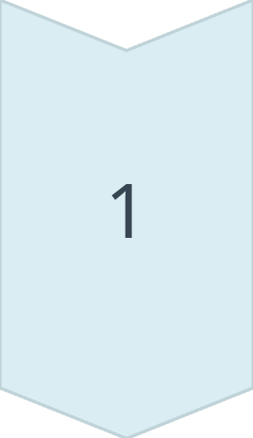
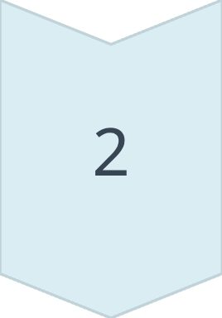
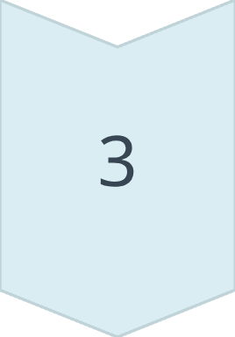
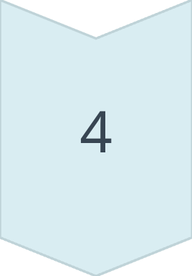
Network Topology Design
Hybrid Topology
Combines Star topology for local area networks (LANs) within each branch and a Hub-and-Spoke wide area network (WAN) with Melbourne HQ as the central hub.
Scalability
Enables easy addition of new branch offices without redesigning the entire network infrastructure.
Fault Isolation
Branch failures are localized, preventing disruptions to other offices and ensuring business continuity.
Centralized Security
Allows for unified security policies and management from a single point, simplifying enforcement and monitoring.

Slide 3
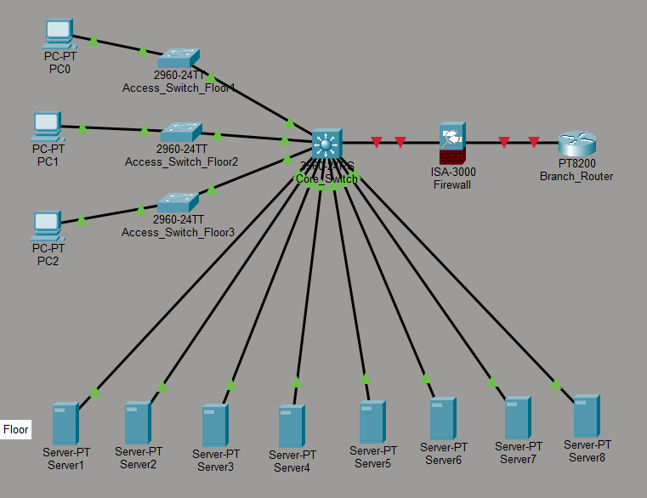
LAN Design for Branch Offices
Access Layer
Layer-2 switches providing connectivity for end-user devices, ensuring efficient data transfer within the local segment.
Distribution/Core Layer
Layer-3 switches handle inter-VLAN routing and provide high-speed backbone connectivity, enhancing network performance.
Server VLAN
Dedicated VLAN for 8 critical servers located on the 4th floor, offering enhanced security and resource isolation.
Edge Firewall
Strategic placement between the LAN and WAN router for perimeter security, inspecting and filtering incoming/outgoing traffic.
This hierarchical LAN structure enhances performance, security, and simplifies management across all branch offices.

Slide 4
VLSM-based IP Addressing
Our network utilizes the private IP range 172.61.0.0/16 with Variable Length Subnet Masking (VLSM) to optimize IP address usage and ensure efficient allocation. Subnets are allocated from largest to smallest to accommodate current and future growth.
Branch
Network Subnet
Subnet Mask
Max Hosts
Melbourne HQ
172.61.0.0
/20
4094
Sydney
172.61.16.0
/20
4094
Kuala Lumpur
172.61.32.0
/21
2046
Perth
172.61.40.0
/21
2046
This strategic IP allocation not only optimizes current IP usage but also provides ample room for future network expansion without significant reconfigurations.

Slide 5

Network Security Measures
Protecting NovaVision Solutions' data and infrastructure is paramount. We address potential threats with a multi-layered security approach.
Threats Identified
DDoS Attacks
Phishing
Ransomware
Data Breaches
Key Controls
Next-Gen Firewalls + IDS/IPS
VLAN Segmentation
VPN/SD-WAN with Encryption
MFA for Administrators
Security Policies
Strict Server Access Controls
Role-Based Access Control (RBAC)
Continuous Monitoring & Auditing

Slide 6

Ethics & Hardware for a Resilient Network
1
Hardware Specifications
ACS Code of Professional Ethics
WAN Routers
Adherence to principles of Public Interest, Privacy, and Professional Competence guides all network design and implementation decisions, ensuring responsible IT practices.
Enterprise-grade for robust inter-branch connectivity.
Switches
2
Layer-2 and Layer-3 switches for efficient LAN traffic management.
Data Security & Regulations
IT professionals are obligated to secure sensitive data and comply with all relevant industry regulations and legal frameworks.
Firewalls
Next-gen firewalls with integrated IDS/IPS for advanced threat protection.
3
Cabling
Ethical Oversight
Cat 6 for high-speed LAN connections, fiber optics for backbone infrastructure.
Maintaining transparency and integrity in all network operations and data handling processes is crucial for building trust.

Slide 7
Key Takeaways: A Future-Ready Network
Hybrid Network Architecture
Centralized control with segmented LANs for optimal performance and manageability across all NovaVision Solutions offices.
Efficient IP Allocation
VLSM implementation ensures optimal IP usage, minimizing waste and providing flexibility for future growth and expansion.
Robust Security Posture
Comprehensive security policies and advanced controls, including next-gen firewalls and MFA, safeguard against evolving cyber threats.
Scalability & Future-Proofing
The design accommodates seamless integration of new branches and technologies, ensuring long-term adaptability.
Continuous Vigilance
Ongoing security monitoring and regular audits are recommended to maintain network integrity and compliance.

